Slide 1
Assembler Final Presentation
Andrew, Ryan, Justice, Kathleen
Notes:
JUSTICE

Slide 2
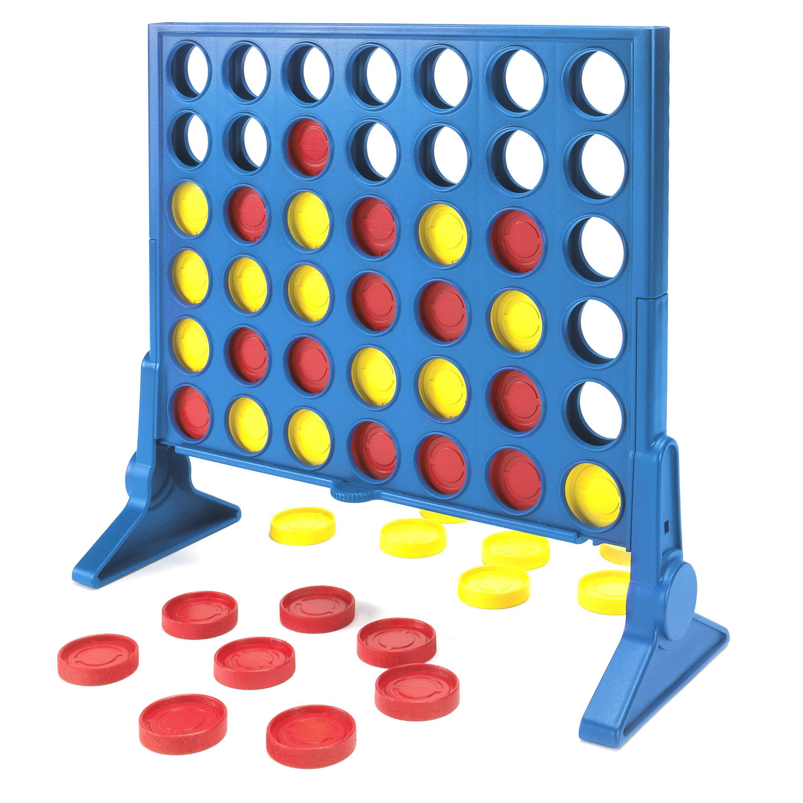
Description of Project
Our group wanted to make a challenging program that would still be fun, plus there are 4 people in our group so connect FOUR just made sense
We wanted to write as much of the project in assembler as possible, ends up we did all of it in assembler! Mission accomplished.
Notes:
JUSTICE

Slide 3
Unique Responsibilities
Justice- Implemented the function to place a tile on the board in Assembly Language
Kathleen- Developed the code layout for the game and implemented the basic framework to accept Justice and Ryan’s functions
Andrew- Developed and integrated the C# UI that we are using for our project
Ryan- Developed and implemented the algorithms we are using to check for a winner in C++ and in Assembly Language
Notes:
RYAN

Slide 4
Design
Main menu
Displays choices for the user to play the game, see their scores, read simple instructions, or exit
It also handles invalid inputs and lets the user retry
Place tile
Only accept valid columns
Make sure column isn’t full and then place the tile as far down the board as possible without writing over another player’s tile
Check for a winner
Checks horizontal, vertical, and both diagonals to see if the player that just placed a tile won or not
Starts calling the check function only after 7 tiles are placed
Notes:
ANDREW
High level description of the design/ architecture of the project

Slide 5
Code Walkthrough/ Demo
TITLE Connect Four Assembler Code;Program Description: Connect Four written entirely in assembler, algorithms and all;Author: Kathleen, Andrew, Ryan, Jusice;Creation Date: 12/01/2016;Latest Revision: 12/07/2016 ; 32-bit assembly language templateINCLUDE Irvine32.inc;----------------------------DATA----------------------------------------.datap1Prompt BYTE "Player 1: what is your name? ",0p2Prompt BYTE "Player 2: what is your name? ",0p1Name DWORD 80 DUP(0)p2Name DWORD 80 DUP(0)MM BYTE 1MMtitle BYTE "MAIN MENU",0MMplay BYTE "1) Play game",0MMinstructions BYTE "2) Instructions",0MMstats BYTE "3) See stats",0MMexit BYTE "4) Exit",0MMprompt BYTE "Please chose a valid value from the main menu (1-4)",0MMinvalid BYTE "Not a valid option, please enter a value 1 - 4",0instruct BYTE "Be the first to place 4 tiles in a row! Switch off between player 1 and 2 until someone wins or the board fills up.",0instructionsTitle BYTE "INSTRUCTIONS",0anyKey BYTE "Press any key to continue...",0board DWORD 42 DUP (?) ;allocates space for a 6x7 boardi DWORD 0blank DWORD " ",0inarow BYTE 1 col BYTE ?row BYTE ?seven DWORD 7validPlace DWORD ?colChoice DWORD 0curCol DWORD 0placed DWORD 0tileDropPrompt BYTE ", where would you like to drop your tile? (Choose columns 1 - 7)",0invalidCol BYTE "Column is full, please choose a different column"invalidB BYTE "Please enter a value between 1 and 7: "win BYTE 48 ;win is going to be a kind of boolean set to either 1 or 0 in asciiplayer DWORD 15 ;player 1 is 15, player 2 is 254 (both ascii characters)winnerTxt BYTE " won!",0drawTxt BYTE "It's a draw!",0scorePrompt BYTE " score is ",0p1Score DWORD 0 ;holds scores of player 1p2Score DWORD 0 ;holds scores of player 2againUser BYTE 49 ;againUser is a aboolean that is either 1 or 0 in asciiplayAgain BYTE "Would you like to play again? Enter 1 for yes and 0 for no: ",0endGameMsg BYTE "Thank you for playing connect four, come back soon!",0;-------------------------------MAIN FUNCTION------------------------------------- .codemain proc call askName ;ask users names at beginning and then not again while program is runningBeginGame: call mainMenu ;display main menu cmp MM, 49 ;if MM == 1 play the game je Play cmp MM, 52 ;if MM == 4 end the game je EndGame cmp MM, 50 ;if MM == 2 give instructions and jmp to beginning jne Next call instructions jmp BeginGame Next: cmp MM, 51 ;if MM == 3 display stats and jmp to beginning jne Next1 call displayStats jmp BeginGame Next1: mov edx, offset MMinvalid ;if none of the above are called, then display invalidMM and jmp to beginning call WriteString jmp BeginGame Play: call playGame mov eax, white+(black*16) ;reset screen colors to out of game mode call settextcolor call Clrscr call again ;sees if the user wants to play again cmp againUser, 49 je BeginGame ;if yes, start the game over, if no then continue and thank the user for playingEndGame: call Clrscr mov edx, offset endGameMsg ;ends program and thanks user for playing call WriteString call Crlf call sysPause call exitProcessmain endp;---------------------------------FUNCTION TO ASK USER NAME-----------------------------------askName PROC USES EAX EDX ECX mov edx, offset p1Prompt ;asks P1 name call WriteString mov ecx, 80 mov edx, offset p1Name ;reads P1 name call ReadString call Crlf mov edx, offset p2Prompt ;asks P2 name call Writestring mov ecx, 80 mov edx, offset p2Name ;reads P2 name call ReadString call Clrscr retaskName endp;---------------------------------FUNCTION TO DISPLAY MAIN MENU-----------------------------------mainMenu PROC USES EDX EAX call Clrscr mov edx, offset MMtitle ;title call WriteString call Crlf mov edx, offset MMplay ;play call WriteString call Crlf mov edx, offset MMinstructions ;instructions call WriteString call Crlf mov edx, offset MMstats ;stats call WriteString call Crlf mov edx, offset MMexit ;exit call WriteString call Crlf call Crlf mov edx, offset MMprompt ;prompt call WriteString xor eax, eax call ReadChar mov MM, al retmainMenu endp;---------------------------------FUNCTION FOR INSTRUCTIONS-----------------------------------instructions PROC USES EDX EAX call Clrscr mov edx, offset instructionsTitle ;display instruction title call WriteString call Crlf mov edx, offset instruct ;display instructions call WriteString call Crlf call Crlf call sysPause retinstructions endp;---------------------------------FUNCTION TO DISPLAY STATS-----------------------------------displayStats PROC USES EDX EAX call Clrscr mov edx, offset p1Name ;name of player --> scorePrompt --> score call WriteString mov edx, offset scorePrompt call WriteString mov eax, p1Score call WriteInt call Crlf mov edx, offset p2Name call WriteString mov edx, offset scorePrompt call WriteString mov eax, p2Score call WriteInt call Crlf call sysPause retdisplayStats endp;---------------------------------FUNCTION TO PLAY GAME-----------------------------------playGame PROC USES EDX call Clrscr call emptyBoard call displayBoardGame: cmp curCol, -1 je ChooseRow cmp player, 15 jne elseP2 mov edx, offset p1Name call WriteString mov edx, offset tileDropPrompt call WriteString mov player, 254 jmp ChooseRow elseP2: mov edx, offset p2Name call WriteString mov edx, offset tileDropPrompt call WriteString mov player, 15 ChooseRow: cmp placed, 42 ;if board is full then game over je Place call ReadInt ;otherwise read in char from user mov colChoice, eax dec colChoice cmp colChoice, 7 ;ensure row choice is valid jb Place cmp colChoice, 0 jae Place mov edx, offset invalidB call WriteString jmp ChooseRow ;while (true) Place: cmp placed, 42 ;if the board is full game over je GameOver call placeTile ;otherwise call placeTile to set curCol cmp curCol, -1 jne checkWin ;if curCol is -1 then the column is full mov edx, offset invalidCol call WriteString jmp ChooseRow checkWin: ;otherwise check for a win cmp placed, 6 jb Enough call check ;check for a win and change the value of win if someone won to exit loop Enough: inc placed call Clrscr call displayBoardcmp win, 48je Game ;WILL THIS JUMP TO THE TOP?GameOver: call Clrscr call displayBoard call updateStats ;announces winner and updates scores call sysPause ;system("Pause") retplayGame endp;-------------------------------FUNCTION TO EMPTY BOARD-------------------------------------emptyBoard PROC USES ECX EAX EBX ESI mov esi, offset board mov ebx, blank xor eax, eax mov ecx, 42
Loop1: mov [esi + eax * 4], ebx
inc ea loop Loop1
ret
emptyBoard endp;---------------------------------FUNCTION TO DISPLAY BOARD----------------------------------- displayBoard PROC USES EAX ECX mov eax, white+(blue*16) call settextcolor call Clrscr mov ecx, 6 mov i, 6 Loop4: call setRow dec i loop Loop4 retdisplayBoard endp;-------------------------------FUNCTION TO CREATE A ROW OF THE BOARD-------------------------------------setRow PROC USES EAX ECX ;outputs a row of boxes using ascii characters mov ecx, 7 Loop1: ;ouputs first third of a row of 7 boxes mov al, 218 call Writechar mov al, 196 call Writechar mov al, 191 call Writechar mov al, BYTE PTR blank call Writechar loop Loop1 call crlf mov ecx, 7 Loop2: ;ouputs second third of a row of 7 boxes mov al, 179 call Writechar mov esi, offset board mov eax, i mul seven push ecx add ecx, eax mov al, BYTE PTR [esi + ecx] ;(board[curCol(j) + curRow(i) * 7]) i = ecx of first loop, j = ecx of second loop call Writechar pop ecx mov al, 179 call Writechar mov al, BYTE PTR blank call Writechar loop Loop2 call crlf mov ecx, 7 Loop3: ;ouputs last third of a row of 7 boxes mov al, 192 call Writechar mov al, 196 call Writechar mov al, 217 call Writechar mov al, BYTE PTR blank call Writechar loop Loop3 call crlf retsetRow endp;--------------------------------FUNCTION TO PLACE TILE------------------------------------placeTile PROC USES EAX EBX
;set CurCol as the return value of placeTile() adn whatever ends up returning will return the value in curCol ;get column mov row, 5 ;WHY IS THIS 5? ;WHERE DO YOU CHECK if(col < 0 || col >= 7) then return -1 .WHILE row >= 0 movzx eax, row mul seven add eax, colChoice .IF board[eax] == " " ;check to see if spot is not filled jmp place ;jmp to function to place the tile .ENDIF dec row .ENDW mov curCol, -1 ;set -1 if not a valid option(column is full) ret place: ;LOOK AT C++ CODE AND MODEL FUNCTION AFTER THAT movzx eax, row mul seven add eax, colChoice mov ebx, player mov board[eax], ebx ;drop player tile into column mov curCol, 1 ; ret placeTile endp;---------------------------------FUNCTION TO CHECK FOR A WINNER-----------------------------------check PROC USES EAX EBX EDX;set win as the "return value" of check() and whatever ends up returning will return the value in win mov al, BYTE PTR colChoice mov col,al mov al, BYTE PTR curCol mov row,al ;check horizontal ;go lef .WHILE col > 0 mov eax,curCol mul seven add eax,colChoice mov ebx,eax movzx eax,row mul seven add al,(col - 1) mov edx,board[eax] .IF board[ebx] == edx inc inarow .IF inarow == 4 mov win,49 ret .ENDIF .ELSE jmp next1 .ENDIF dec col
.ENDW next1: mov al, BYTE PTR colChoice mov col,al ;go right .WHILE col < 6 mov eax,curCol mul seven add eax,colChoice mov ebx,eax movzx eax,row mul seven add al,col+1 mov edx,board[eax] .IF board[ebx] == edx inc inarow .IF inarow == 4 mov win,49 ret .ENDIF .ELSE jmp next2 .ENDIF inc col .ENDW next2: mov inarow,1 mov al, BYTE PTR colChoice mov col,al ;check vertical ;go up .WHILE row > 0 mov eax,curCol mul seven add eax,colChoice mov ebx,eax movzx eax,(row - 1) mul seven add al,col mov edx,board[eax] .IF board[ebx] == edx inc inarow .IF inarow ==4 mov win,49 ret .ENDIF .ELSE jmp next .ENDIF dec row
mul seven add eax,colChoice mov ebx,eax movzx eax,(row+1) mul seven add al,col mov edx,board[eax]
.IF board[ebx] == edx inc inarow .IF inarow ==4 mov win,49 ret .ENDIF .ELSE jmp next4 .ENDIF inc row
Notes:
KATH
A very brief, high level, “code walkthrough” to show the rest of the class the code your group wrote. Describe the general outline of your code, but please don’t walkthrough your code line by line.

Slide 6
Lessons Learned
It can be helpful to write your program in a language you know well and then translate it once you find a way that works (if you have the time)
Communication is key to making a project work, which I think is why we were able to get it done on time
Test your code as you go, don’t just assume it will work when you compile it later
Notes:
KATH

